Slide 1
WELCOME

Slide 2
Health Center Management System

Slide 3

PRESENT SYSTEM
Every sort of work is done on mush paper.
Burden to store information for long period of time.
Work is Laborious.
Difficult to maintain the information about the drugs and there expiry dates.

Slide 4
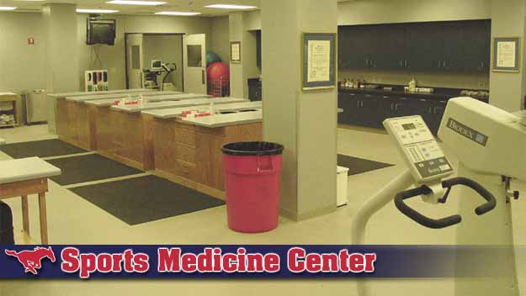
PRESNT DRUG STORES
Nearly 2000 drugs are maintained in large records.
It is very difficult to notify what are the drugs need to be ordered.
It is very difficult to notify the expiry dates of the every drug and it is very laborious to notify for every drug as every drug has two or more expiry dates in the store.

Slide 5
Disadvantages of Present System
Difficult to store the information.
Work is Laborious.
More man power is needed for every sort work

Slide 6
Modified Version
of
Present System

Slide 7

MODIFIED VERSION
Every Department in the Health center are computerized.
Departments are
  Registration.
  Drug Stores.
  Case Records of Patients.
  Pharmacy Daily Entries .

Slide 8
REGISTRATION OF PATIENTS
Just we enter the details of the members in the
university for providing the free services yearly
once and maintained in the database.
Service is provided to the patient by viewing the
information in the database.

Slide 9
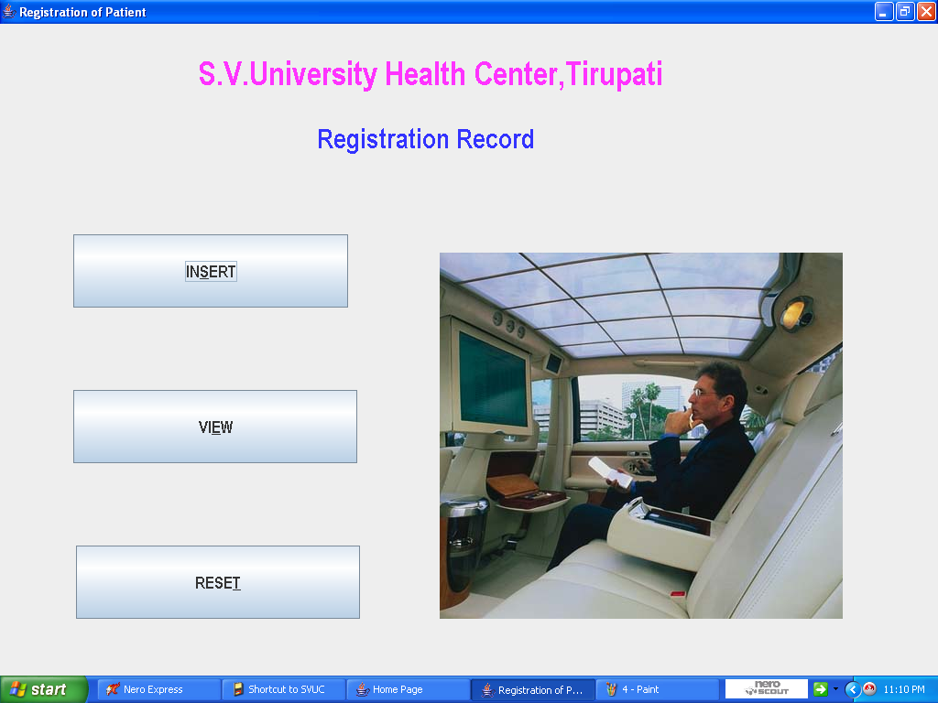
Registration Process

Slide 10
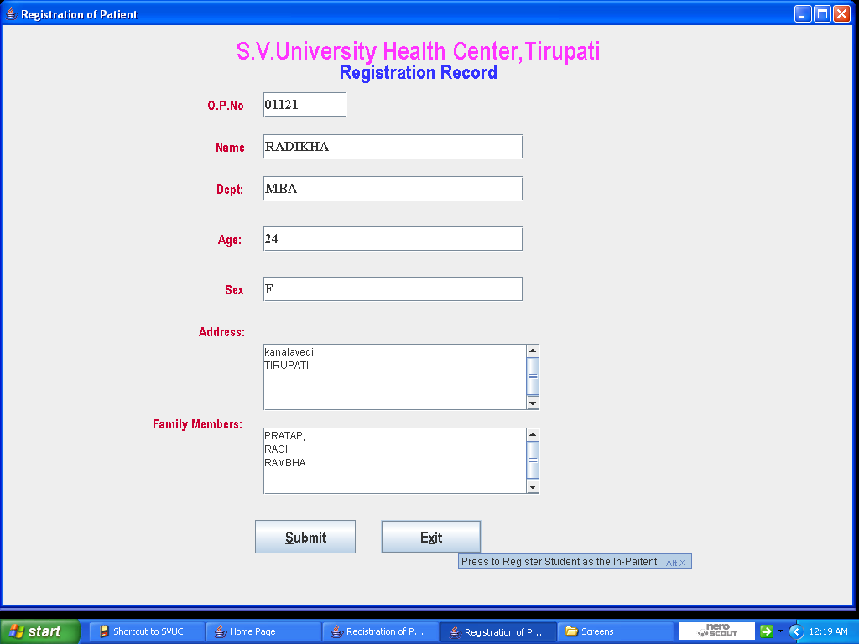
Registration Process

Slide 11
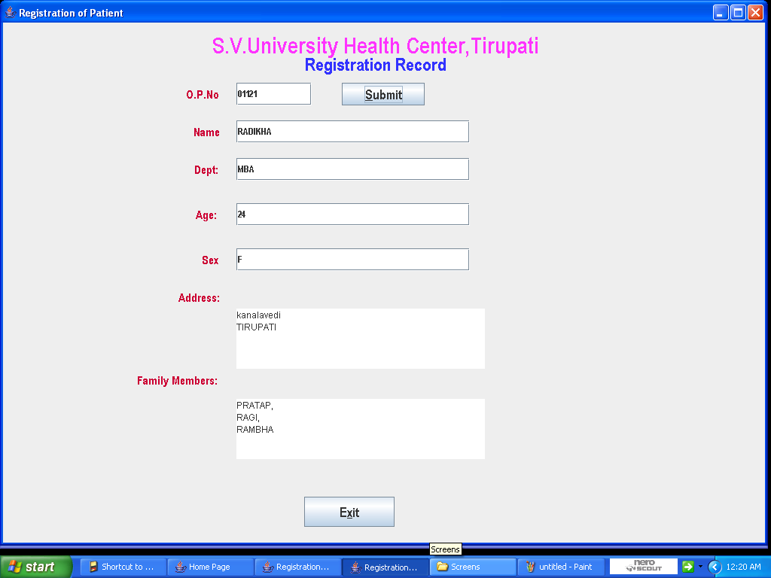
Registration Process

Slide 12
Drug Store Processes
As there are different drugs that are emerging today each is entered into the database.
Stock of Main Drug Stores and Pharmacy House are maintained separately.
We can Expiry date alert for every drug.

Slide 13
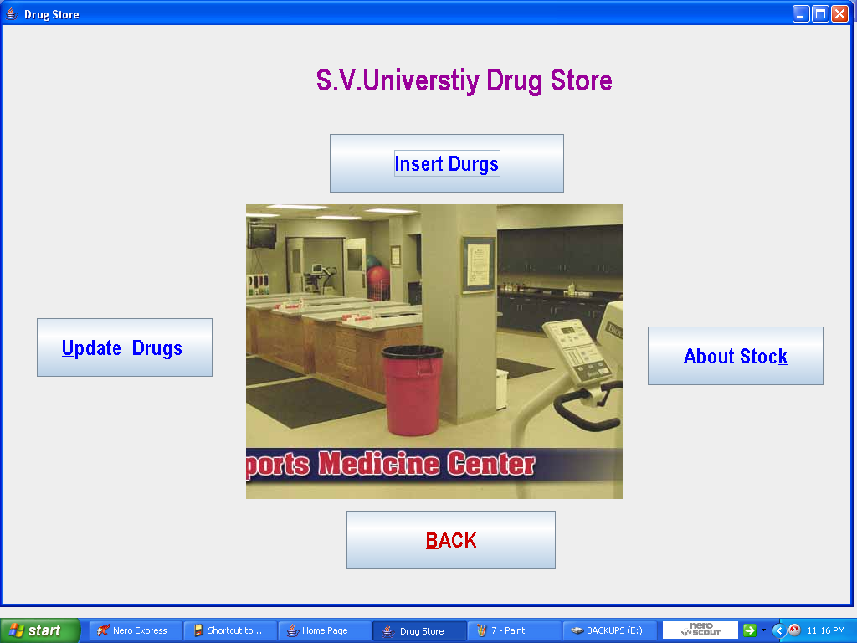
Drug Stores

Slide 14
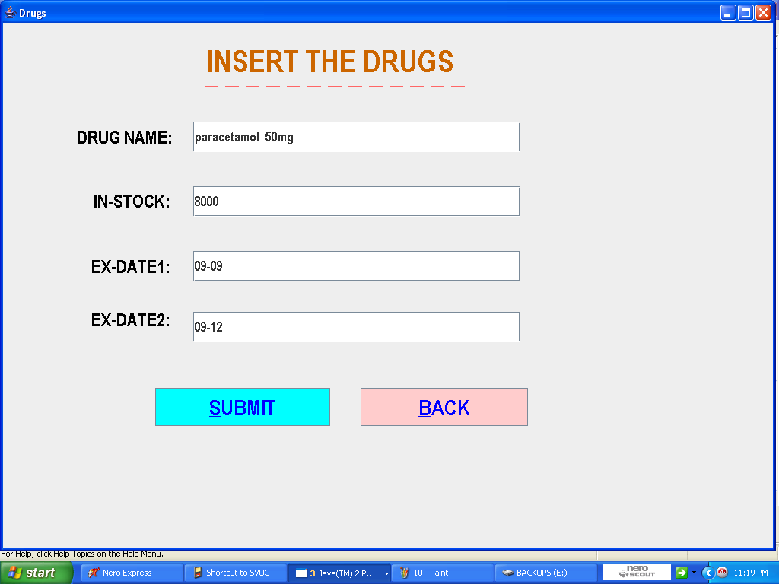
Drug Stores

Slide 15
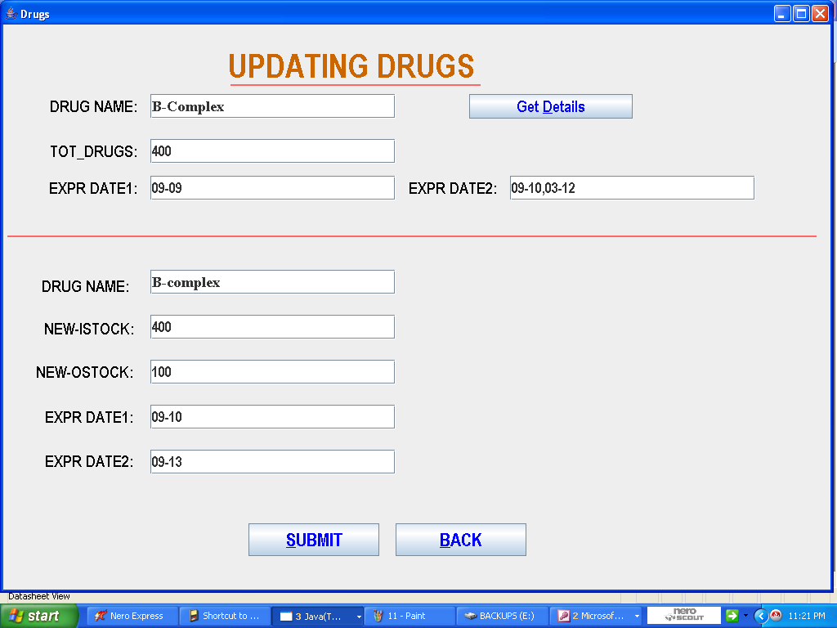
Drug Stores

Slide 16
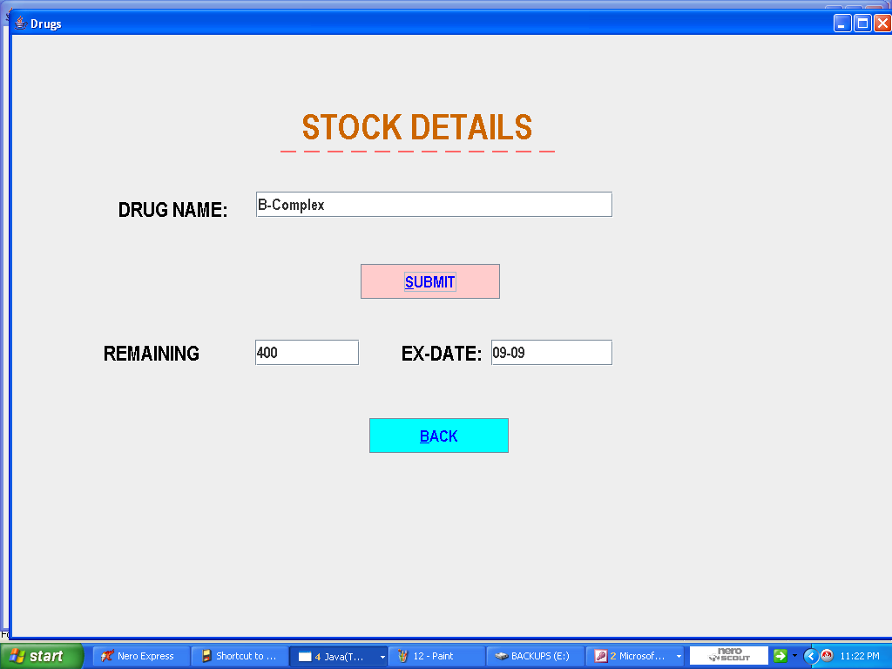
Drug Stores

Slide 17
Advantages
Man power is reduced.
Easy to operate.
User friendly.
Information is Stored For long period of time

Slide 18


Thank 'U'

